Slide 1
Proposal for Spacecraft Light Curve Analysis
Kent Rush

Slide 2
Introduction and Background

Slide 3
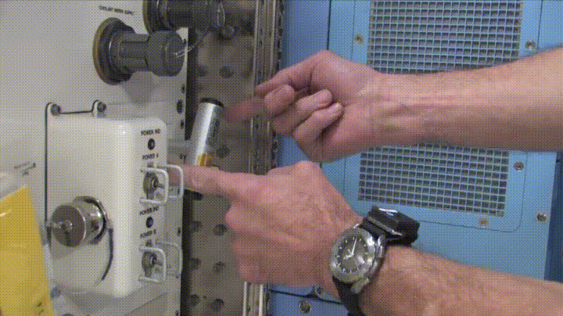
My Proposed Thesis
Develop Kalman Filter to estimate angular velocity of a tumbling spacecraft from only a light curve.
Apply this method to real data.
Angular velocity estimation has been done before but only for stable or zero spin states.
Image Credit: NASA

Slide 4
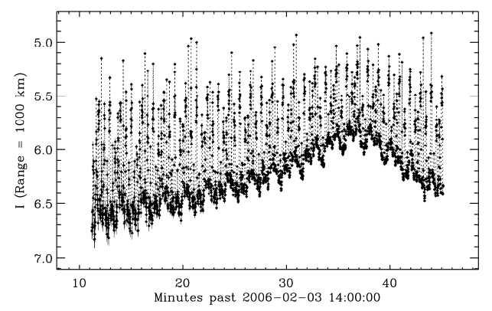
What is a Light Curve
Light curves are data collected by observing the brightness of an object as it passes over an observer.
Light curve analysis has been applied to natural celestial bodies such as planets and asteroids long before it was applied to artificial satellites.
Light curve from IMAGE spacecraft [1]

Slide 5
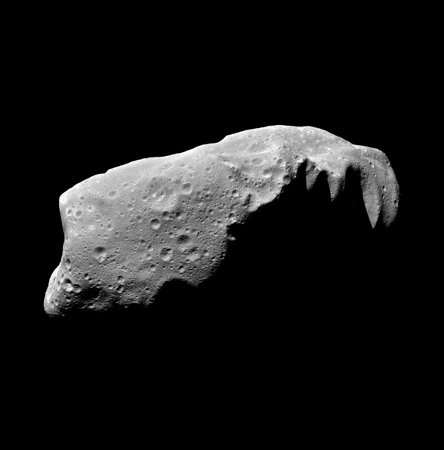
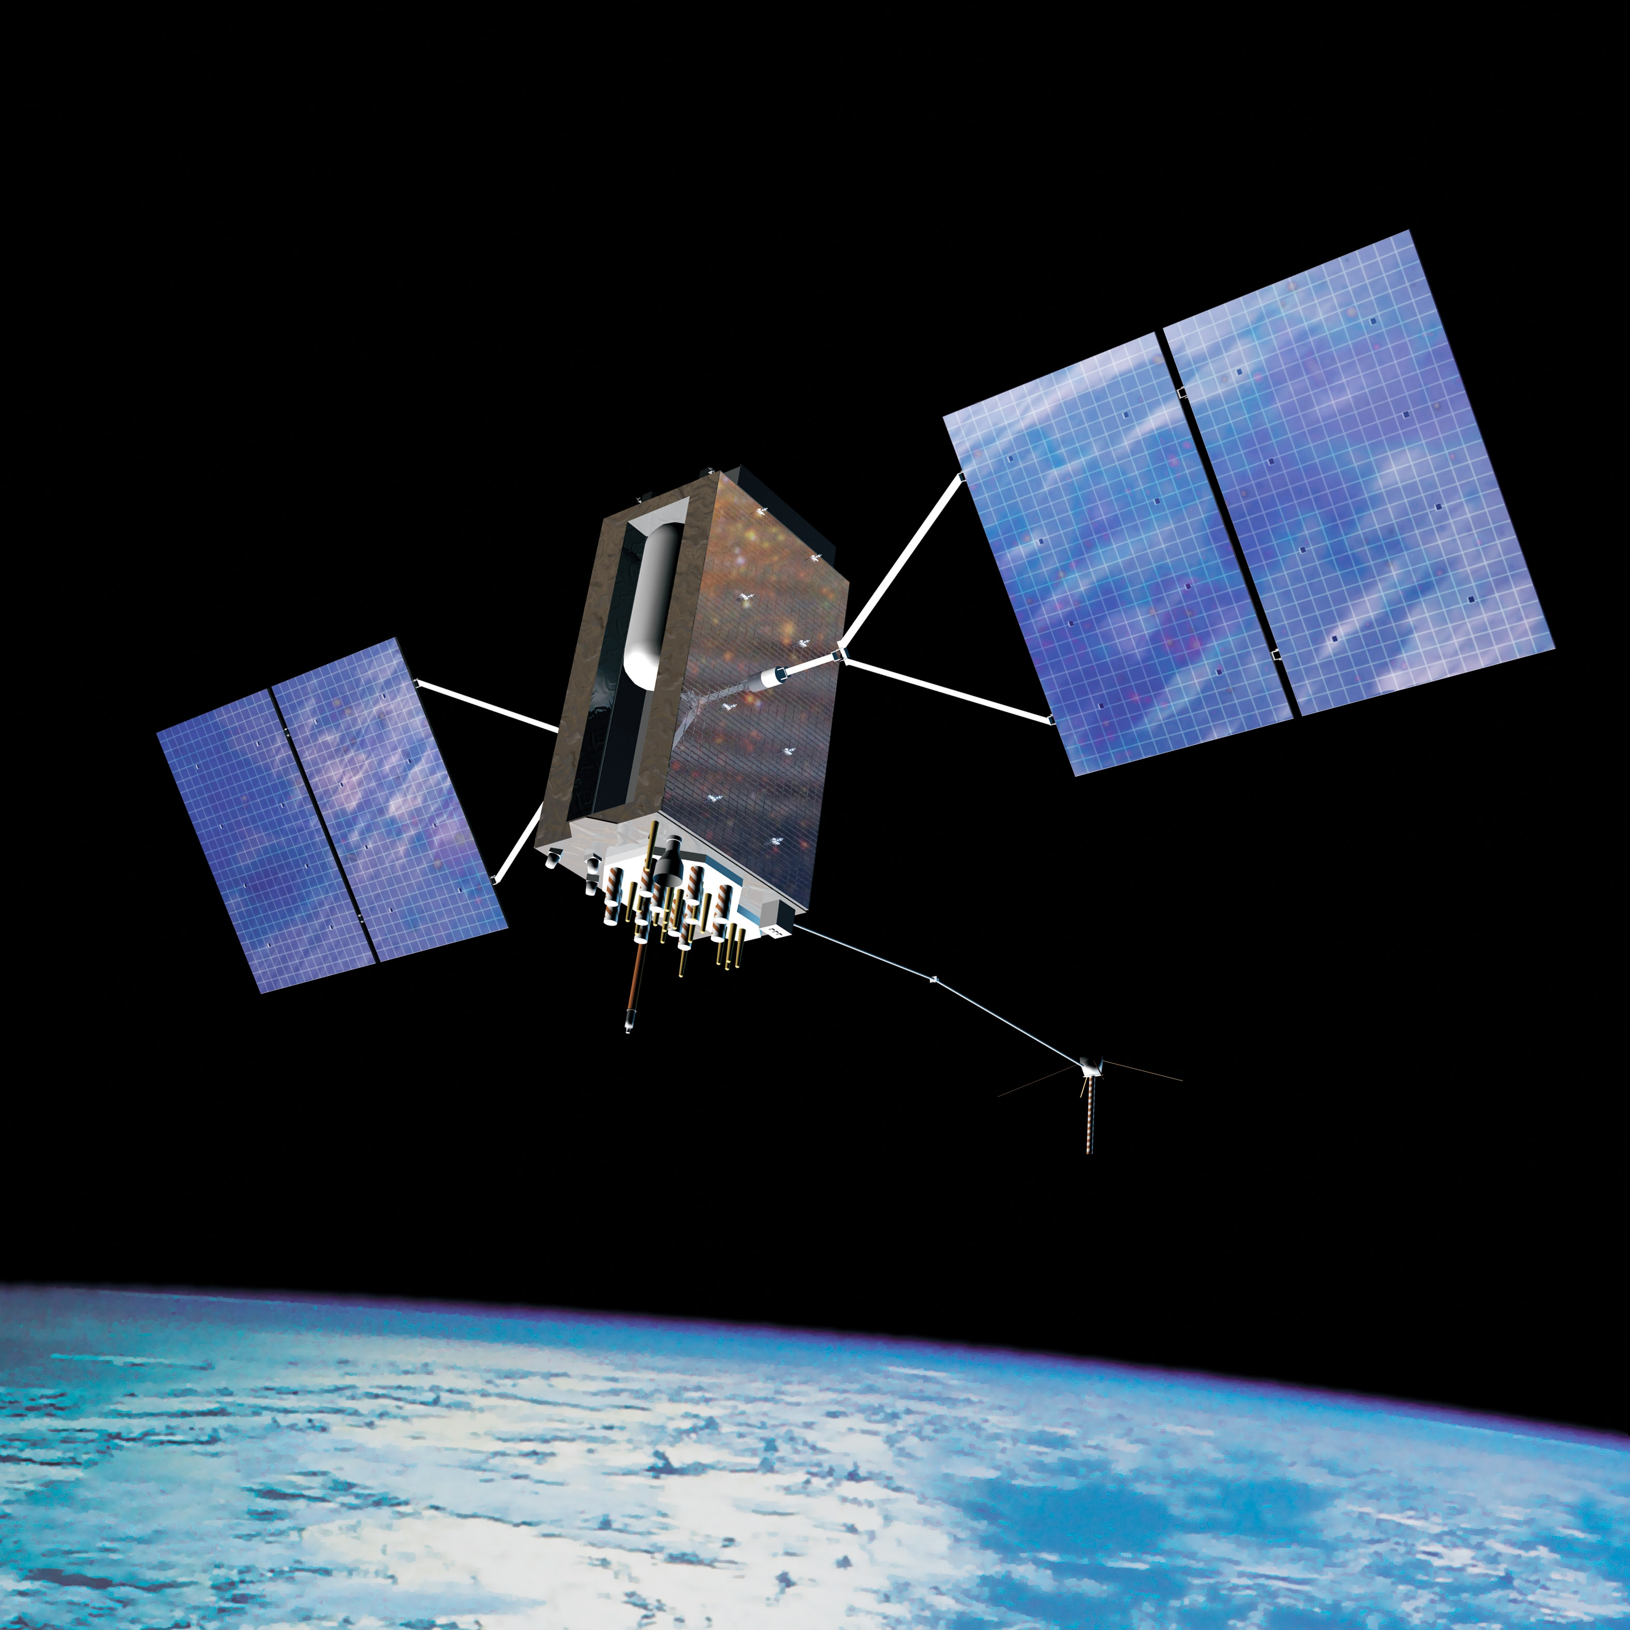
Differences Between Spacecraft and Celestial Bodies
Geometry
Albedo
Perturbations
Concavity
Control
Chaotic Tumbling
Image Credit: NASA

Slide 6
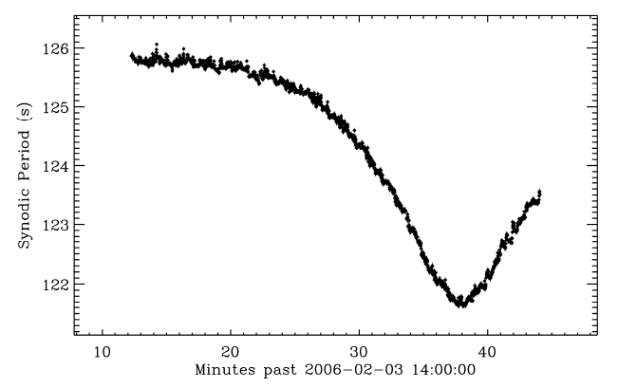
Synodic Period Estimation
The synodic period refers to the period of the spacecraft as viewed from earth.
Due to the Earth’s rotation, the synodic period is the non-inertial period between the spacecraft and the observer.
Synodic period of IMAGE spacecraft [1]

Slide 7
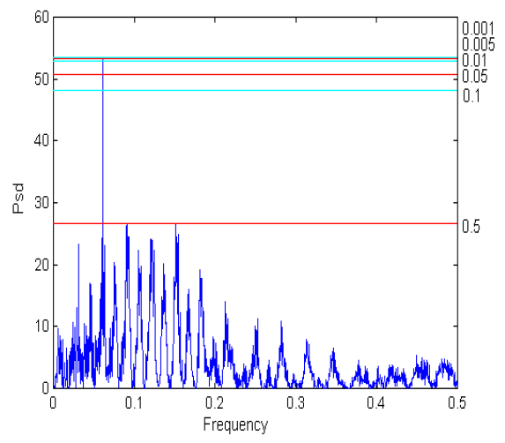
Synodic Period Estimation
The Synodic Period can be calculated by finding the largest component frequency of the light curve.
This method assumes a spin about a constant axis (major axis).
Frequency Decomposition using Lomb-Scargle periodogram [2]

Slide 8
Sidereal Period Estimation
Sidereal Period is the Period of the rotation in the inertial frame.
This is much more useful than the Synodic Period.
This is calculated using the Epoch Method.

Slide 9
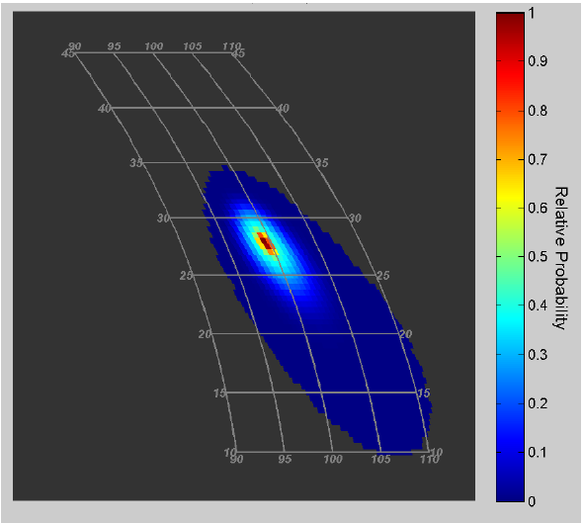
Epoch Method
Calculate the synodic period across the duration of the pass.
Perform a grid search by guessing all possible spin axes.
Simulate change in synodic Period assuming each spin axis.
Select axis that best fits data.
Probable spin axis distribution for rocket body [3]

Slide 10
Beyond Epoch: Kalman Filtering
Shape Determination [6]
Orbit Estimation [7]
Attitude Estimation[8]
Assumed zero angular velocity
Filtered attitude, angular velocity, position and velocity
Verified in simulation
Ran multiple filters each assuming a different geometry and picked the closest match
Assumed constant angular velocity
Filtered attitude, angular velocity, position, velocity and mass
Verified in simulation
Assumed constant angular velocity
Filtered attitude, angular velocity
Applied to real data but was unsuccessful

Slide 11
Motivations
Debris Removal
National Security
Operations
How fast is this spacecraft spinning?
In what way is this spacecraft spinning?
Is this spacecraft pointing at targets of significance to national security?
Is my spacecraft behaving as expected?
Is my spacecraft under control?

Slide 12
Is this new? Yes.
In my review of the literature, only Wetterer and Jah applied their UKF to real data.
No papers proposed a method for estimating arbitrary angular velocities

Slide 13
Goals
Develop a formulation of the Unscented Kalman Filter
Implement a highly accurate reflectance model
Deploy UKF and reflectance model to real data
Create a formulation of the UKF that can closely estimate the attitude and angular velocity of an unresolved, tumbling spacecraft
Implement highly accurate reflectance model with the aim of allowing the analysis of data form spacecraft with self-shading geometries. This is also necessary to increase the ability of the UKF to converge to accurate values.
Interpret real data and get meaningful results.

Slide 14
Methodology

Slide 15
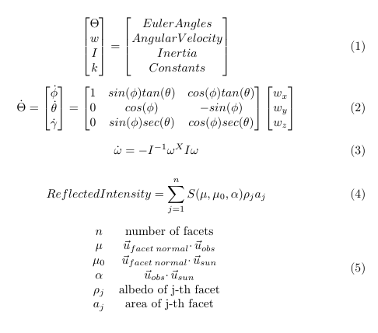
Kalman Filter Formulation
Unscented Kalman filter outperforms normal KF in very nonlinear system.
Uses Euler angles because they are continuous, unbounded, unconstrained, can be averaged and has non-singular covariance.
Lommel-Seeliger reflectance law for now, Phong BRDF eventually.
Constants are values for telescope gain, facet albedo, etc.

Slide 16
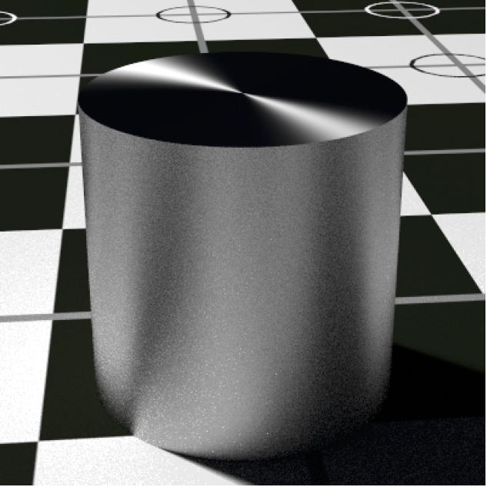
Reflectance Model
“Ray Tracing”
Phong BRDF
Algorithm
Obeys conservation of energy
Accounts for Fresnel behavior and anisotropic reflection
Accurately models decreasing diffuse component as incident angle decreases
Calculate the percentage of each facet that is not occluded
Apply the Phong BRDF model for the reflectance of each facet accounting for occlusion
Breaks up each facet into multiple small facets
Calculates the occlusion for each sub-facet given sun vector and observation vector.
Example of Phong BRDF + Ray Tracing [9]

Slide 17
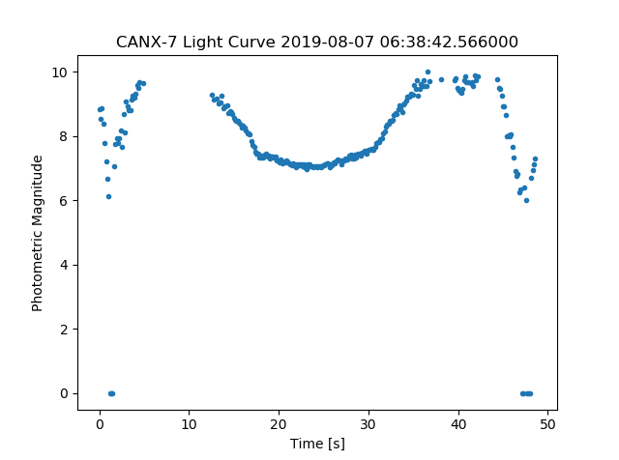
Application to Real Data
Position of spacecraft relative to sun and observer will need to be accurately simulated for each dataset.
Old TLE files will be requested from Celestrak
Rotation of the earth during the pass will need to be modelled to capture synodic effects

Slide 18
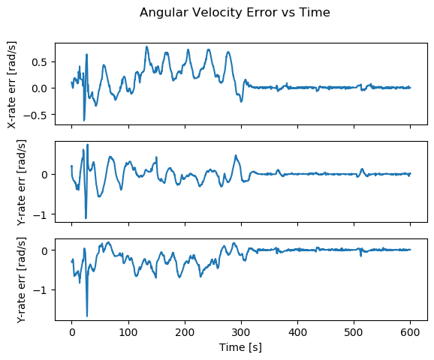
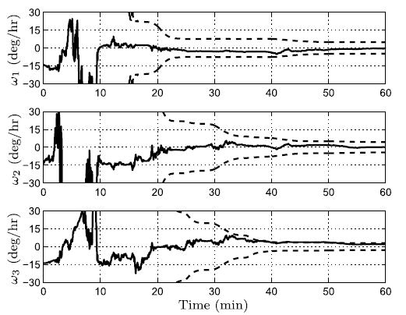
Verification
Verification in simulation is as simple as comparing the UKF output with the truth model values.
Since the true values for real data do not necessarily exist, spacecraft with known attitudes
My verification plot
Published verification plot [6]

Slide 19
Analysis Plan

Slide 20
Minimum Criteria
Develop an Unscented Kalman Filter that can estimate attitude and angular velocity to a useful degree.
Apply UKF to real data.
If application to real data fails, determine the quality of data that would enable this method of analysis.

Slide 21
Proving Results
Against Simulated Data
Against Real Data
For testing against simulated data, a truth model of the spacecrafts attitude and angular velocity will be simulated to compare against. A light curve will be generated from this model with noise added. A positive result using this data would show the UKF state estimate of angular velocity and attitude converging on the same values as the truth model.
For real data, proving the results is not possible for most cases. However, data can be analyzed for spacecraft in known orientation and spin states. A positive from these known spacecraft would show the estimated attitude and angular velocity matching published values.

Slide 22
Schedule
Fall Quarter |  |  |  |  | Winter Quarter |  |  |  |  | Spring Quarter
Wk 1-2 | Wk 3-4 | Wk 5-6 | Wk 7-8 | Wk 9-10 | Wk 1-2 | Wk 3-4 | Wk 5-6 | Wk 7-8 | Wk 9-10 | Wk 1-2 | Wk 3-4 | Wk 5-6 | Wk 7-8 | Wk 9-10
Literature Review |  |  | Proposal |  |  | Prep Seminar | Seminar | Write Thesis |  |  |  | Defense | Thesis Buffer time
 | Develop UKF Formulation |  |  |  | Develop “Ray Tracing” BRDF simulation |  |  | Buffer time for coding
 |  |  | Develop accurate Truth Simulation |  |  | Verify in Simulation |  | Analyze Real Data

Slide 23
Challenges by parts
Unscented Kalman Filter
“Ray Tracing” BDRF Model
Using Real Data
Most states that we are interested in measuring are only indirectly related to the measurement.
A very accurate model is needed remove ambiguities in the data.
The UKF formulation should only require inputs that are usually available.
Complex algorithm and outside of my own experience.
Potentially needs to be written in C++ and interfaced with my Python scripts to increase computation speed.
Requires accurate spacecraft models which may be difficult to acquire
Simulated data can be as pristine and plentiful as is necessary for my UKF formulation to work. Real data is messy, filled with holes, and scarce.
A method of augmenting data or combining data from multiple passes may be required.

Slide 24
References
Doyle Hall, J Africano, D Archambeault, B Birge, D Witte, and P Kervin. Amos observations of nasa's image satellite. -1:76, 01 2006.
Roberto Tagliaferri, Angelo Ciaramella, Leopoldo Milano, Fabrizio Barone, and Giuseppe Longo. Spectral analysis of stellar light curves by means of neural networks. Astronomy and Astrophysics Supplement Series, 137, 06 1999.
Doyle Thomas Hall and Paul W. Kervin. Optical characterization of deepspace object rotation states. 2014.
Ben K. Bradley and Penina Axelrad. Lightcurve inversion for shape estimation of geo objects from space-based sensors. 2014.
Calef B. Knox K. Bolden M. Hall, D. and P. Kervin. Separating attitude and shape effects for non-resolved objects. 2007.
Richard Linares, Moriba K. Jah, John L. Crassidis, and Christopher K. Nebelecky. Space object shape characterization and tracking using light curve and angles data. Journal of Guidance, Control, and Dynamics, 37(1):13{25, 2014.
Richard Linares, Moriba K. Jah, John L. Crassidis, Fred A. Leve, and Tom Kelecy. Astrometric and photometric data fusion for inactive space object mass and area estimation. Acta Astronautica, 99:1 { 15, 2014.
Charles J. Wetterer and Moriba K. Jah. Attitude determination from light curves. Journal of Guidance, Control, and Dynamics, 32(5):1648{1651, 2009.
Michael Ashikhmin and Peter Shirley. An anisotropic phong brdf model. J. Graph. Tools, 5(2):25{32, February 2000.

Slide 25
Backup Slides

Slide 26
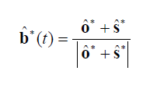
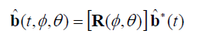
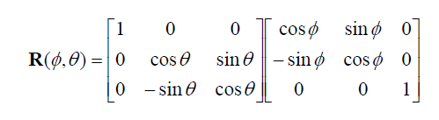
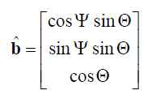
Epoch Method
Principal Axis Bisector
* represents Inertial Frame
Rotation matrix from ECI to Spin Axis frame.
Where φ and θ define the right ascension and declination of the spin axis.
Components of PAB with respect to azimuthal and axial angles in the Spin Axis frame

Slide 27
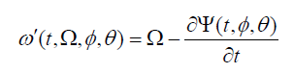
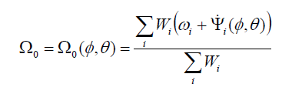
Epoch Method
Equation for predicted sidereal frequency ω’ at time t given sidereal period Ω and the change in azimuthal angle of the PAB
Best fit sidereal frequency as a function of spin axis
W = Δω⁻²
Plot of the measured synodic period ω over time

Slide 28
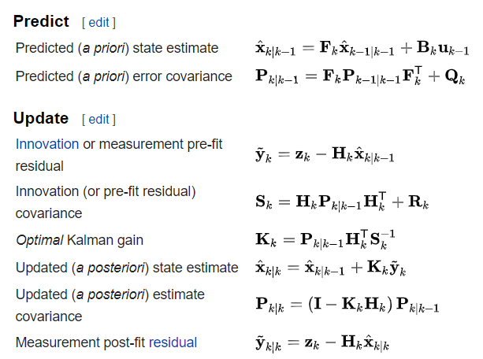
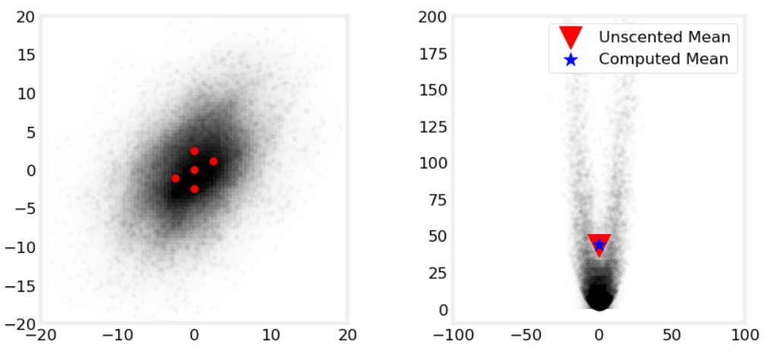
EKF vs UKF
Extended Kalman Filter Algorithm
Sigma points being transformed by non-linear function
From Kalman-and-Bayesian-Filters-in-Python by Roger Labbe.
https://github.com/rlabbe/Kalman-and-Bayesian-Filters-in-Python/blob/master/10-Unscented-Kalman-Filter.ipynb
From Wikipedia: Kalman Filter

Slide 29
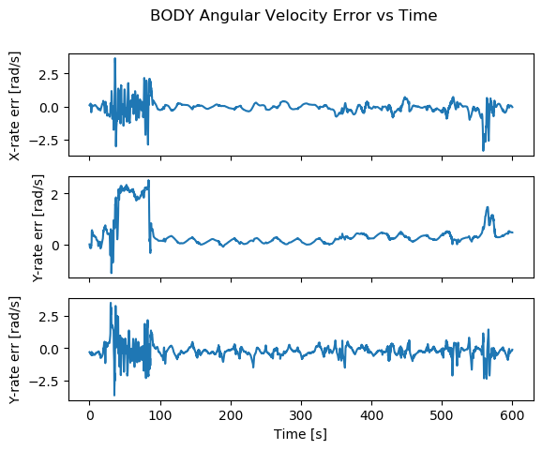
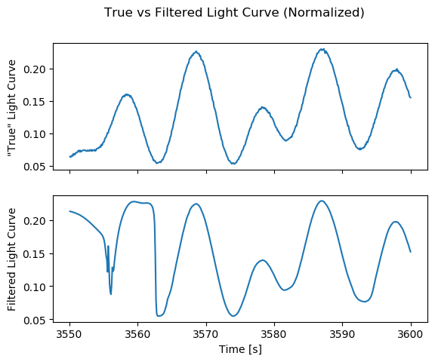
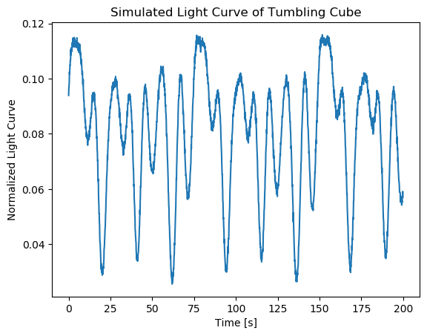
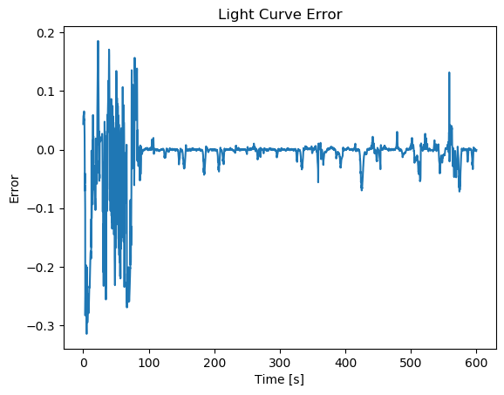
Preliminary Results
UKF consistently finds states that accurately reproduce the simulated “true” light curve
The estimated angular velocities converge to correct order of magnitude
Attitude is completely wrong
There is ambiguity in current model

Slide 30
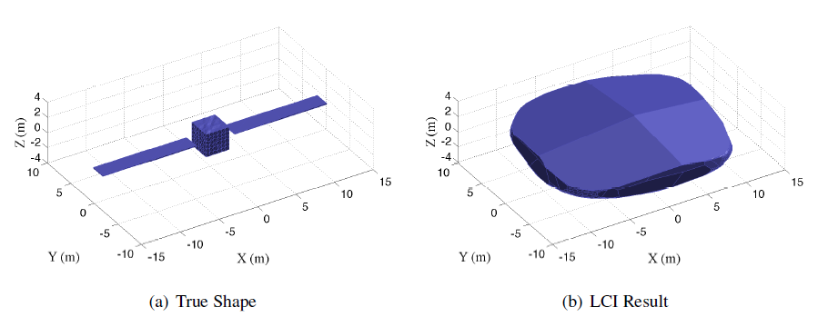
Light Curve Inversion
Light Curve Inversion (LCI) is a technique developed by M. Kaasalainen et. al. to estimate the shape of asteroids.
Creates a large set of normal vectors for each facet and optimizes their area to best fit the measured light curve
Results of LCI: Truth vs Estimated Hull [4]

Slide 31
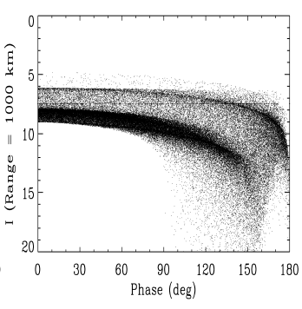
Phase-Angle-Brightness Plots
P-A-B plots are essentially a profile of a spacecraft for every given Phase angle
Phase angle is the angle between the sun vector and observation vector
Can be used for comparisons
Example P-A-B plot [5]

